Slide 1

R in Biometrics - AstraZeneca approach to enable R Shiny apps for Drug Project activities
Ruhul Amin
Company Restricted

Slide 2
Agenda
Overview of R Portfolio (10 min)
R Capability Team
Strategic vision
Key priorities and deliverables
Governance framework
Enable R use in Biometrics (10 min)
Biometrics use cases
Deployment of R Shiny apps
Lessons learnt and the next steps
Advice on ‘How to get started’
Q&A (5 min)
10Feb2025

Slide 3
R Capability Team
Data Automation
Strategic Governance Lead
Business Project Lead
Project Manager
Technical Lead(s) and SME(s) for each of the key areas i.e. infrastructure, foundational components, validation framework & processes, change management, package validation, A&R system deployment
Business Functions
Biometrics Therapeutic Areas – Oncology, Respiratory & Inhalation, Cardiovascular Renal & Metabolism, Rare Diseases, Vaccine & Immunisation
Data Science & Artificial Intelligence
Real World Evidence
Clinical Operations
Clinical Pharmacology
IT
R&D IT
A&R Product
Enterprise Technical Services
Scientific Computing Platform
Compliance
Business Quality Management
IT Quality Management
10Feb2025

Slide 4





Strategic Vision
R Business Architecture to support GxP and Exploratory use cases
Strategic Direction
Enable Biometrics to utilise R/Open-Source as a tool for both Exploratory and Regulatory activities for Drug Projects
Use Cases
Key business purposes (e.g. SDTM/ADaM Creation, Visualisation, Modelling, Simulation)
Framework and Architecture
R Governance, Package Requests and Validation Process, R Business Architecture on valid platforms
Challenges
Inconsistent requirements for using R across Therapeutic Areas, funding for future infrastructure, Biometrics SME commitment for subjective review of package validation

Slide 5

Key Priorities and Deliverables
Study/Project Support
Data transformation, drug project study and safety reporting, ISE/ISS
Other Use Cases
QC/QA, vendor oversight, exploratory use, publications
COMPLETED
IN PROGRESS
Foundational items to manage and effectively assess risk of R packages - package validation framework, Package Request Manager app and Risk Assessment tool, user guidance and processes
R in Biometrics - study submission and TFL generation, shadowing studies in collaboration with Biometrics stakeholders (PoC completed)
Validated workflows - processes and tools enabling users to setup and develop R programs for A&R patient data on Computing Platform
R Package Validation – deployed 250+ validated packages on GxP validated A&R System for submission activities, future lead time reduced from 6m+ to 1-3m through automation
GxP-Qualified Container Infrastructure - to host R Shiny Apps through R container for Study level interactive analyses for exploratory use
GxP-Qualified R Container to enable validated R Shiny app for submission level activities

Slide 6
Governance Framework
Strategic Governance Team
‘Support through partnerships’
Operational Committee (includes Change Advisory Board)
Responsible for implementation of Roadmap
Approve/Reject significant changes for implementation based on recommendations from R Users Advisory Board
Discuss any future major changes, or wider/enterprise changes that may have impact on the system(s) in scope.
Review risks/issues and operational matters
R Users Advisory
Board
Business SMEs with R and domain knowledge expertise
Focused on Packages and capabilities
Assess and prioritize Package Validation requests, changes and risks associated with the changes.
Accountable for Strategic Roadmap for R/Open-Source in R&D
Visibility into Industry Trends, Vendors
Ensuring the environment(s) remain consistent and fit for purpose via user base engagement
Communication and Outreach to Sponsors/Senior Leadership and Functions
Enabling change and maximising value
10Feb2025

Slide 7
Biometrics Use Cases
Enable open-source (R/Shiny, Python) environment(s) for both GxP and exploratory activities. This will ensure the availability of fit-for-purpose tools for the right jobs e.g. Python for GenAI, R for resource intensive modelling and simulation.
Event prediction, design packages, advanced survival analyses, subgroup analyses, post-hoc analyses
Regulatory compliant system for R based reporting for both primary (early phase studies) and exploratory (IEMT) analyses
Strategy and roadmap for open-source programming languages (R, Python) and alignment with existing AstraZeneca systems
R Shiny apps for on demand clinical data visualisation and ad-hoc and subgroup analyses.
Aid-in with CSR review
Integration with existing A&R systems and data repositories
10Feb2025

Slide 8
R Shiny app deployment options, past and future
Physical hardware or hardware virtualisation
Scientific Computing Platform and PositConnect
Very basic deployment without user session management
Validated R workflow (in-house developed R package) to connect to clinical study data
Software Virtualisation
R Container via Kubernetes (non-PositConnect option)
Validated R workflow (in-house developed R package) to connect to clinical study data
Users unable to easily deploy their own R Shiny apps
Domino (option for building, hosting and managing containers)
Ideal state is to have PositConnect service where:
Users can easily deploy their own R Shiny apps
Apps run within a user session
Integration with A&R Systems securing any transient data at rest
10Feb2025

Slide 9






Containers
Container Images are “Blueprints for Automation”
Hours/Days -> Seconds/Minutes
Containers package “everything” into reusable and self-contained units
Operating system, R Language, R Packages, R Application
Everything is version-locked
Enable simplified and quick deployment of
R applications
Automated R package testing
Containers can run in many different environments
Facilitate GxP compliance by providing consistent and reproducible environments
GxP-qualified infrastructure to support this is available within AstraZeneca
10Feb2025

Slide 10
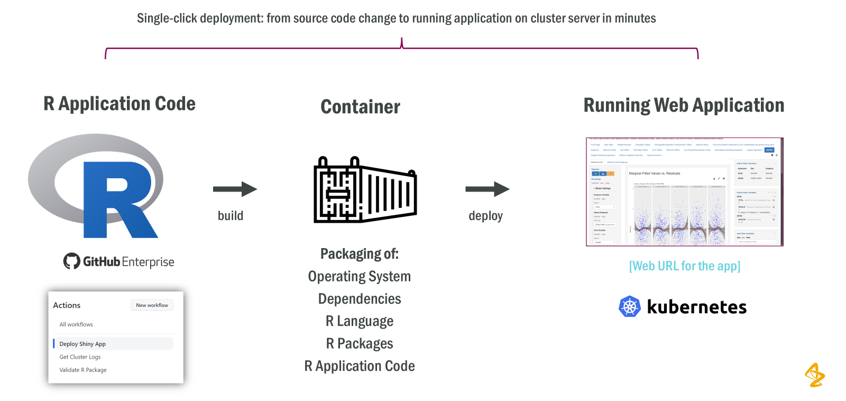
Application Automation Using Containers
10Feb2025

Slide 11
Deployment of an in-house developed R Shiny data analysis app
Prerequisite knowledge
R Shiny Development
Basic Git skills and familiarity with AZ GitHub
Development environment – getting started
Clone the template repository in AZ GitHub
A general template for R Shiny applications
README file includes detailed instructions on how to get started
A skeleton Shiny application is included with the template, replace with your own code as needed
Run the Deploy Webapp Action
This creates a container with the necessary R environment + your R application code
The Shiny application is deployed to the Kubernetes cluster
The application gets its own URL
Deployment only takes a few minutes, enabling quick iterations
Push new code and rerun the Deploy Webapp action as needed (or configure it to run automatically)
10Feb2025

Slide 12
R Shiny app deployment steps – getting started
Access to clinical study data for exploratory use is through the in-house developed validated R package
A template containing setup instructions and code examples are provided for user/developer
Integration with Single Sign-On (SSO) for user-based authentication/authorisation is also provided through the validated R package
Infrastructure
AZ GitHub Enterprise
We have created actions, workflows and templates for building container images and deploying R Shiny applications to the Kubernetes clusters
Kubernetes clusters (AWS-based)
Harbor container repository
10Feb2025

Slide 13
R Shiny app deployment steps – compliance requirements
Dev and Test deployments can be initiated by the developer through GitHub workflows, but Production deployment is performed through a standardised process co-ordinated with IT
Production documentation must be in place
Application Blueprint
Risk Impact Determination (RID)
Privacy Impact Assessment (PIA)
Blueprint Self-Review
Acceptance to Service
IT Security Review, if indicated by Blueprint Self-Review
Once testing is completed and all the documentation are in place, the exact same container as was used in the Test environment is deployed to the Production environment
10Feb2025

Slide 14
Qualification and Validation
Container Qualification Steps
The scope of qualification/validation will target how clinical study data (files) are fetched from production A&R system using validated R package and stored within container session.
Steps/documents include:
Risk Impact Determination (RID)
Privacy Impact Assessment (PIA)
Test Approach, Validation Plan, Test Script, User Acceptance Test (UAT)
Validation Report
Installation Qualification (IQ), Operational Qualification (OQ)
Validation Requirements (app level) for GxP use
AstraZeneca software validation framework/SOP as applicable, Business Quality Manager to be consulted
10Feb2025

Slide 15
Lessons learnt and the next steps
Test the application early in the development and test environments by mimicking production environment loads (data file sizes, number of concurrent users)
initiate software-architectural discussions (including app scalability) between development and deployment teams at the start of the project
Agree with Biometrics Senior Leaders on long-term (next 2-5 years) strategic vision and roadmap for R/Open-Source Portfolio
10Feb2025

Slide 16
Advice on ‘How to get started’
Based on our journey into R/Shiny, we have the following suggestions for industry partners who would like to adopt a similar change management as ours.
Governance framework, cross-functional collaboration, support team
Infrastructure and foundational pieces (e.g. package validation framework, package request management tool, risk assessment tool), use cases with clear requirements, process & guidance
Clinical study data pulled from A&R Systems requiring integrations with other systems
Data are accessed with requesting user’s access permissions
Data are secured at rest if written to storage system
Data are always transient/temporary and removed automatically after a set period
Set realistic expectations!
10Feb2025

Slide 17

Thank you

Slide 18

Q&A

